Slide 1
LS/Supply Chain
WHAT
WHY
Business Challenges
Use Case Description
KPIs Impacted
Smart Maintenance Operational Framework
Reactive Maintenance Costs: Organisations often face significant financial loss because issues are only addressed after a failure occurs , leading to expensive emergency replacements rather than low cost , proactive repairs.
Operational Downtime: Undetected equipment degradation or workflow bottlenecks cause unexpected halts in production, logistics or service delivery, ultimately impacting overall reliability.
SOP Compliance: Employees often lack immediate access to the right Standard Operating Procedures (SOPs) for diverse asset models, slowing down resolution time.
The Concept: A unified AI platform that transform maintenance from a manual “check and fix” process into an automated “predict and guide” system. It monitors real time data, usage logs and system triggers to identify deviations.
The Mechanism: When an anomaly is identified, such as a machine vibration anomaly, the issue is triaged for severity, and an alert is created for human review. Once approved, a work ticket is created. Guidance is provided to the worker using official SOPs. Once the work is conducted, an audit register is produced based on the worker’s maintenance logs.
The Output: Tickets are generated when anomalies occur. This is a step-by-step service process via RAG. This ensures standardised, high quality responsive across any industry, whether the task is mechanical repair, a safety inspection or facility turnover.
Reduce equipment replacement costs
Reduce maintenance turn around time
Reduce SME interruption hours
Reduce unplanned downtime
Reduce repeat failures / rework
Improve SOP compliance
Increase staff confidence &competency
Increase productivity per technician
An AI‑driven platform that transforms maintenance from a reactive “check and fix” activity into a predictive, guided workflow. It continuously monitors real‑time equipment data, usage logs, and system signals to identify deviations early, orchestrate compliant maintenance actions, and support consistent execution through validated SOP‑based guidance and audit‑ready outputs.
Business Impact
HOW
WHO
Reduce repair costs and equipment replacements
Increase staff productivity and minimise disruption
Accelerate and standardisemaintenance workflows
Improve safety and operational reliability
Reduce training overhead for temporary staff
Functional Solution
Technical Solution
Stakeholders
Identifies Anomalies: For Maintenance Intervention
Ticket Generation: Tickets generated when anomalies occur to be reviewed by an engineer for processing.
Interactive SOPs: Digitalise complex manuals into searchable, easy to follow format.
Audit: Create and updates Audit register, for Human review.
AI Foundry
React JS
RAG
Microsoft Fabric
Entra ID
Operations Managers
Maintenance Operators
Repair Engineers
Other Engineers
Facilities Managers
Housing Developers

Slide 2
Use Case Scope in the Business Process
LS/Supply Chain
Smart Maintenance Operations Framework
Use Case scope
L1
Equipment Operations & Maintenance
L2 4 sub-processes
Plan & Prepare Maintenance Activities
Execute Maintenance & Support Operations
Monitor, Predict & Protect Equipment Health
Quality, Compliance & Decision Support
PROCESSES
Inventory mapping
Critical Assets
triage
Plan & schedule Work Orders
Budgeting
Maintenance data & findings
Preventative Maintenance
Monitor equipment data and predictive maintenance or faults
Triage and send Alert
Review of alert an work ticket created
SOP Compliance
Conduct Maintenance Activities
Generate Audit register
Review Maintenance Records & logs
L3 13 macro tasks
L4 36 micro tasks
AGENT
AGENT
AGENT
AGENT
AGENT
Inventory Manager
Critical Assets Manager
Scheduling Manager
Findings Manager
Predictive Maintenance Manager
Alert manager and ticket generator
SOP and chat agent
Audit Agent
Content Manager
Territory Selector
Selector
Sales Call Manager
DATA & AI
RAG
Data platform, data governance, data management
Transforming the apps landscape, integrating with apps, infrastructures & data landscapes:
DIGITAL
Third Party
Data
Equipment Data
Maintenance CRM
Equipment CRM
Intranet
Other Tools
Human
RPA/script
AI/ML
Gen AI
Agentic AI
Outcomes
(if at scale)
+ 45-75%
+ 30-50%
+ 80-95%
+ 40-60%
Faster Maintenance Cycle
Reduced Unplanned Downtime
Accurate Predictive Health Insight
Productivity

Slide 3

AI-Human Chemistry
LS / Supply Chain
Smart Maintenance Operations Framework
Monitor and predicts faults
Phase 1
Feedback for model improvement or Invalid alerts
Interaction (customer, third- party or internal teams)
Inbound Channels
Secondary reviewer
Agent interacting only with systems not with humans
Monitor equipment data and predict maintenance or faults
Triage the severity/priority
Alert triggered
Human in the loop: reviews complex or unclear alerts
​
Human In the Loop: Reviews Alert
Equipment Sensor Data
Work ticket
Generate work ticket
Phase 2
AI Guidance & SOP Support Agent
Retrieves SOPs using RAG and summarises them into steps
Chatbot to provide guidance and
Provides interactive, step‑by‑step guidance
Completes and records maintenance work
Inbound Channels
Reviews audit register
Work ticket from Agent 1
SOPs and guidance
Consolidates maintenance records
Creates audit register

Slide 4
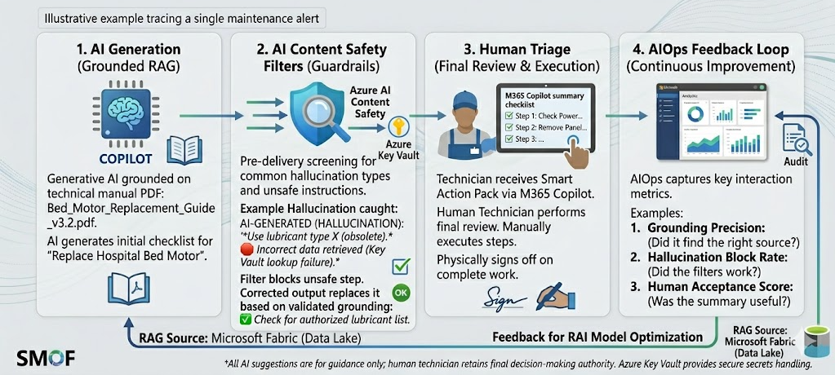
Responsible AI
LS / Supply Chain
Smart Maintenance Operations Framework

Slide 5
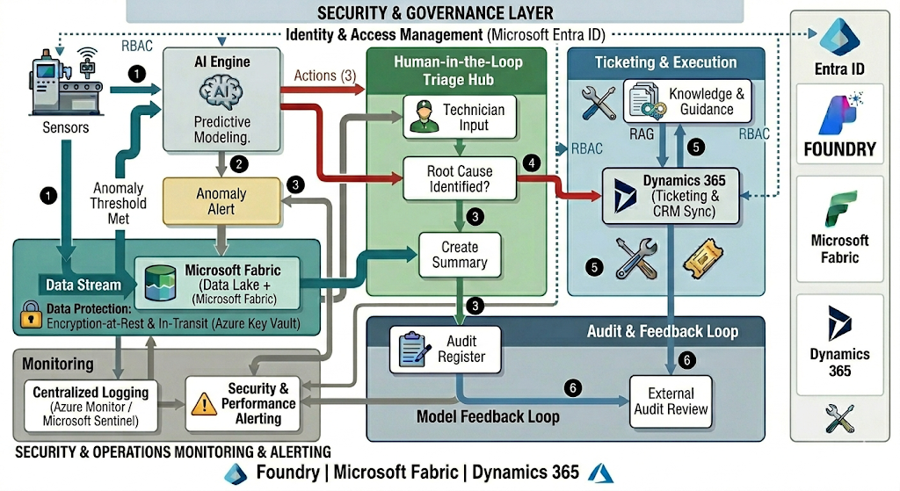
Technical Solution
LS / Supply Chain
Smart Maintenance Operations Framework
Technologies
technologies
AI Foundry
React JS
GPT 4.1
RAG
Microsoft Fabric

Slide 6
Business Case Proposal
LS / Supply Chain
Smart Maintenance Operations Framework
WHY
BUSINESS CASE
KPIs Impacted
Current Costs
Current Income
Reduce equipment replacement costs
Reduce maintenance turnaround time
Reduce SME interruption hours
Reduce unplanned downtime
Reduce repeat failures / rework
Improve SOP compliance
Increase staff confidence & competency
Increase productivity per technician
Running(R1): £ 100,000.00
Maintenance(M1):£150,000.00
Total Current Cost(TCC)= £250,000.00
(UK BCIS‑aligned annual cost ranges used by UK FM providers for reference facility size of 10,000 m²)
Revenue (Rv1): £3,571,000.00
New Income
New Costs
Revenue (Rv2): £3,678,130.00
Implementation(I): £380,000.00
Running(R2): £80,000.00
Maintenance(M2): £120,000.00
Total New Cost(TNC): £200,000.00
Business Impact
BREAK EVEN:
Time 7 years and 6 months required to pay the Implementation using Savings
BREAK EVEN:
Time 3 years and 5 months required to pay the Implementation using extra Revenue
Reduce repair costs and equipment replacements
Increase staff productivity and minimise disruption
Accelerate and standardise maintenance workflows
Improve safety and operational reliability
Reduce training overhead for temporary staff
Why it’s feasible:
Predictable return within a typical enterprise ROI window
Immediate cost savings + long‑term revenue uplift
More stable, less reactive maintenance operations
Strong ROI after break‑even
Breakeven:
Savings begin immediately, reducing operating costs from year one.

